Slide 1
Tenses in English
Simple
Future
Present
Continuous
Simple Present
Present
Perfect
Future
Continuous
Past
Continuous
Simple
Past
Past
Perfect
Future
Perfect

Slide 2
Sentence Structure
S
V
O
+
+
+
H.V.

Slide 3
Question Structure
S
V
O
+
+
+
H.V.

Slide 4
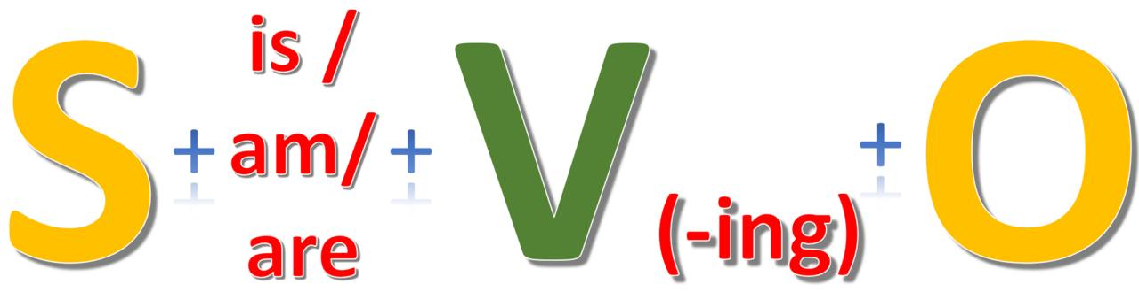

1- Present Progressive /(Continuous)
S
With (Normal) Verbs
With (Be) Verbs
Time /
Place
H.V.
M.V.
O / adj
He, She, It
is /
isn’t
the
news
now,
at the moment
I
am /
’m not
watching
We, They, You
are /
aren’t
He, She, It
is /
isn’t
being
lazy
I
am /
’m not
We, They, You
are /
aren’t

Slide 5
Yes/No Question
+
+
+
S
V
O
H.V.
+
+
S
V
O
H.V.

Slide 6
Forming Questions (Pr. Progressive) + is
WH- Question
+
+
+
is / am / are
V-ing
S
is / am / are
V
O
H.V.
Statement
Yes/No Question
WH- Question (Object / Place)
WH- Question (Subject)
Ali
is
eating
a sandwich
.
Ali
Is
eating
a sandwich
?
.
What
eating
Ali
is
a sandwich
?
.
Ali
is
eating
a sandwich
.
Who
?

Slide 7
Forming Questions (Pr. Progressive) + are
WH- Question
+
+
+
is / am / are
V-ing
S
is / am / are
V
O
H.V.
Statement
Yes/No Question
WH- Question (Object / Place)
WH- Question (Subject)
Doctors
are
treating
a patient
.
the doctors
are
treating
the patient
?
.
the doctors
Who
treating
the patient
?
are
.
Who
Doctors
are
treating
the patient
.
?

Slide 8

2- Past Progressive / (Continuous)
S
Time /
Place
With (Normal) Verbs
With (Be) Verbs
H.V.
M.V.
O / adj
He, She, It,
I
when the phone rang.
when Ali came.
was /
wasn’t
the
news
watching
We, They, You
were /
weren’t
He, She, It,
I
was /
wasn’t
being
lazy
We, They, You
were /
weren’t

Slide 9
Forming Questions (Past Progressive) + was
WH- Question
+
+
was / were
+
V-ing
S
was / were
V
O
H.V.
Statement
Yes/No Question
WH- Question (Object / Place)
WH- Question (Subject)
Ali
was
eating
a sandwich
.
Ali
Was
eating
a sandwich
?
.
Ali
was
eating
a sandwich
?
What
.
Who
Ali
was
eating
a sandwich
.
?

Slide 10
Forming Questions (Past Progressive) + were
WH- Question
+
+
+
was / were
V-ing
S
was / were
V
O
H.V.
Statement
Yes/No Question
WH- Question (Object / Place)
WH- Question (Subject)
Doctors
were
treating
a patient
.
the doctors
Were
treating
the patient
?
.
the doctors
Who
treating
the patient
?
were
.
Who
Doctors
were
treating
the patient
.
?

Slide 11
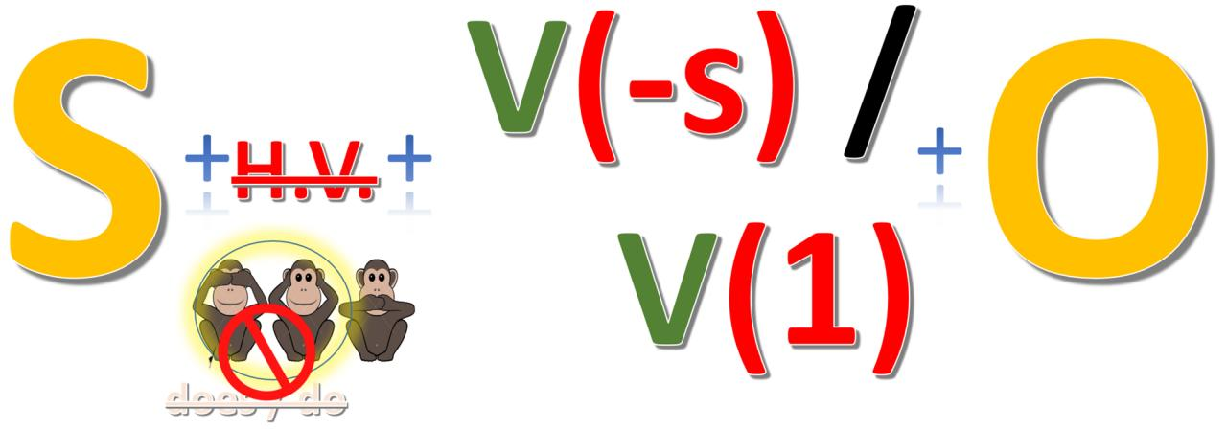
3- Simple Present (shortened)
S
Time /
Place
With (Normal) Verbs
With (Be) Verbs
H.V.
O / adj
/ Prep
M.V.
---
watches /
everyday /
at home
He, She, It
watch
the
news
doesn’t
---
watch /
I, We, They, You
don’t
watch
He, She, It
---
is /
isn’t
angry. /
with Ali.
I
---
am /
’m not
We, They, You
---
are /
aren’t

Slide 12
3- Simple Present (All Verbs)
S
H.V.
Time /
Place
M.V.
With (Normal) Verbs
With (Be) Verbs
With (Modal) Verbs
O / adj
/ Prep
---
watches /
He, She, It
watch
the
news
everyday /
at home
doesn’t
---
watch /
I, We, They, You
don’t
watch
He, She, It
---
is /
isn’t
angry. /
with Ali.
I
---
am /
’m not
We, They, You
---
are /
aren’t
He, She, It, I,
We, They, You
can / must / may
in open water.
swim.
can’t /..

Slide 13
Remember
Note: The following verbs are often used in the Simple present:
(believe, forget, hear, know, like, love, need, prefer, remember, see, understand, want)

Slide 14
Forming Questions (Pr. Simple) + are
WH- Question
+
+
is / am / are
+
O / Place
S
V
H.V.
Statement
Yes/No Question
WH- Question (Object / Place)
WH- Question (Subject)
Players
are
on the plane
.
the players
Are
on the plane
?
.
on the plane
.
the players
are
?
Where
the players
Who
are
on the plane
.
?

Slide 15
Forming Questions (Pr. Simple) + does
+
+
+
WH- Question
V(1)
V(-s) / V(1)
V(-s) / V(1)
S
V
O
does / do
H.V.
Statement
Yes/No Question
WH- Question (Object / Place)
WH- Question (Subject)
Ali
does
eats
a sandwich
.
Does
does
eats
Ali
eat
a sandwich
.
?
Ali
does
does
.
What
eats
a sandwich
?
eat
Who
Ali
does
eats
a sandwich
.
?

Slide 16
Forming Questions (Pr. Simple) + do
+
+
+
WH- Question
V(-s) / V(1)
V(1)
V(-s) / V(1)
S
V
O
does / do
H.V.
Statement
Yes/No Question
WH- Question (Object / Place)
WH- Question (Subject)
Students
do
study
English
.
study
the students
do
study
English
?
Do
.
the students
?
do
What
do
study
.
study
English
students
studies
Who
do
study
English
.
?

Slide 17
Forming Questions (Pr. Simple) + can
WH- Question
+
+
+
Modal
(can)
V(1)
S
Modal
(can)
V
O
H.V.
Statement
Yes/No Question
WH- Question (Object / Place)
WH- Question (Subject)
Ministers
can
meet
the king
.
ministers
Can
meet
the king
?
.
meet
the king
?
Who
can
.
ministers
Who
Ministers
can
meet
the king
.
?

Slide 18
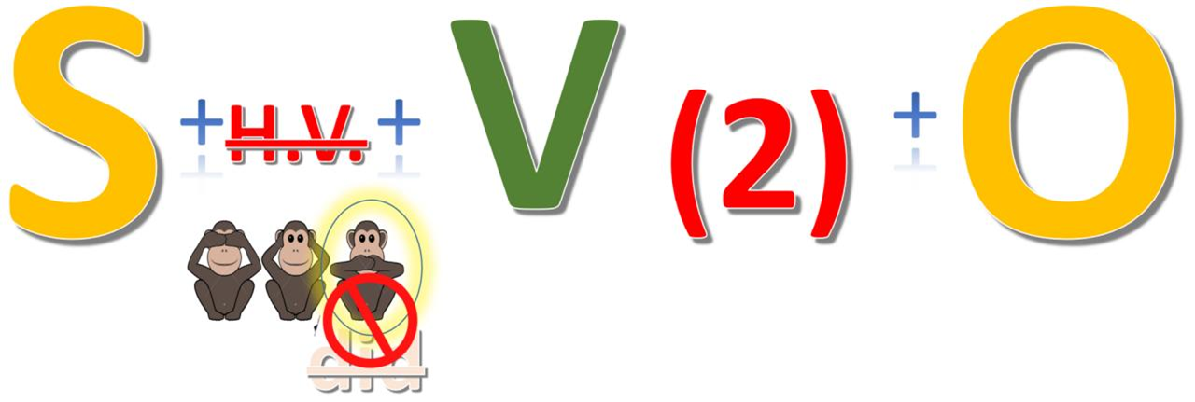
4- Simple Past (shortened)
S
Time /
Place
With (Regular) Verbs
With (Irregular) Verbs
With (Be) Verbs
H.V.
M.V.
O / adj
/ Prep
He, She, It, I, We,
They, You
watched /
---
at home /
yesterday, last session,
2 weeks ago
didn’t
watch
the
news
---
saw /
didn’t
see
He, She, It,
I
was /
wasn’t
angry. /
with Ali.
---
We, They, You
---
were /
weren’t

Slide 19
4- Simple Past (All Verbs)
S
Time /
Place
With (Regular) Verbs
With (Irregular) Verbs
With (Be) Verbs
With (Modal) Verbs
H.V.
M.V.
O / adj
/ Prep
He, She, It, I, We,
They, You
watched /
---
at home /
yesterday, last session,
2 weeks ago
didn’t
watch
the
news
---
saw /
didn’t
see
He, She, It,
I
was /
wasn’t
angry. /
with Ali.
---
We, They, You
---
were /
weren’t
He, She, It, I,
We, They, You
could / had to
in open water.
swim.
couldn’t /..

Slide 20
Forming Questions (Past Simple) + did
+
+
+
WH- Question
V(2)
V(1)
S
V
O
V(2)
did
H.V.
Statement
Yes/No Question
WH- Question (Object / Place)
WH- Question (Subject)
Ali
did
saw
a mouse
.
Did
did
saw
a mouse
?
Ali
see
.
did
What
Ali
did
.
saw
?
see
a mouse
Who
Ali
did
saw
a mouse
.
?

Slide 21
Forming Questions (Past Simple) + could
WH- Question
+
+
+
Modal
(can)
V(1)
S
Modal
(could)
V
O
H.V.
Statement
Yes/No Question
WH- Question (Object / Place)
WH- Question (Subject)
Ministers
could
meet
the king
.
ministers
Could
meet
the king
?
.
Who
meet
the king
?
ministers
could
.
Who
Ministers
could
meet
the king
.
?

Slide 22

5- Present Perfect
S
With (Regular) Verbs
With (Irregular) Verbs
With (have) Verbs
Time /
Place
H.V.
M.V.
O / adj
/ Prep
He, She, It
has /
hasn’t
watched
have /
since the morning,
recently,
lately,
already
I, We, They, You
haven’t
the
news
He, She, It
has /
hasn’t
seen
have /
I, We, They, You
haven’t
He, She, It
has /
lunch /
a job
hasn’t
had
have /
I, We, They, You
haven’t

Slide 23
Forming Questions (Pr. Perfect) + have
WH- Question
+
+
+
has / have
V(3)
S
has / have
V
O / Place
H.V.
The Saudis
Statement
Yes/No Question
WH- Question (Object / Place)
WH- Question (Subject)
have
gone
to space
.
the Saudis
Have
gone
to space
?
.
the Saudis
Where
gone
to space
?
have
.
the Saudis
Who
have
gone
to space
.
?

Slide 24

6- Past Perfect
S
H.V.
M.V.
O / adj
/ Prep
Time /
Place
With (Regular) Verbs
With (Irregular) Verbs
With (have) Verbs
With (Be) Verbs
He,
She,
It,
I,
We,
They,
You
watched
the
news
seen
before the
phone rang.
/
before Ali came.
had /
lunch /
a radio
had
hadn’t
angry /
to Europe
been

Slide 25
Forming Questions (Past Perfect) + had
WH- Question
+
+
+
had
V(3)
S
had
V
O
H.V.
Statement
Yes/No Question
WH- Question (Object / Place)
WH- Question (Subject)
The Chinese
the Great Wall
had
built
.
the Chinese
the Great Wall
Had
built
?
.
the Chinese
the Great Wall
What
built
?
had
.
the Chinese
the Great Wall
Who
had
built
.
?

Slide 26

7- Simple Future
S
Time /
Place
With (Regular) Verbs
With (Irregular) Verbs
With (have) Verbs
With (Be) Verbs
H.V.
M.V.
O / adj
/ Prep
He,
She,
It,
I,
We,
They,
You
watch
next Saturday,
next year,
at 9 o’clock
the
news
will /
see
lunch /
a car
have
won’t
when he meets his x-partner.
angry
be

Slide 27
Forming Questions (Simple Future) + will
WH- Question
+
+
+
will
V(1)
S
V
O
H.V.
will
Statement
Yes/No Question
WH- Question (Object / Place)
WH- Question (Subject)
Fatimah
will
cover
her face
.
Fatimah
Will
cover
her face
?
.
cover
her face
?
Who
will
.
Fatimah
Who
Fatimah
will
cover
her face
.
?

Slide 28

8- Future Progressive (Continuous)
S
H.V.
M.V.
O / adj
/ Prep
Time /
Place
With (Regular) Verbs
With (Irregular) Verbs
With (have) Verbs
He,
She,
It,
I,
We,
They,
You
watching
the
news
next Saturday,
next year,
at 9.15
will be /
seeing
having
won’t be
lunch /
a celebration

Slide 29
Forming Questions (Future Continuous) + will be
WH- Question
+
+
+
V(-ing)
O
S
V
H.V.
will
be
Statement
Yes/No Question
WH- Question (Object / Place)
WH- Question (Subject)
Salim
will
be
watching
the match
.
?
Salim
Will
be
watching
the match
.
watching
the match
.
What
will
be
?
Salim
the match
?
Who
will
be
watching
.
Salim

Slide 30

9- Future Perfect
S
H.V.
M.V.
O / adj
/ Prep
Time /
Place
With (Regular) Verbs
With (Irregular) Verbs
With (have) Verbs
With (Be) Verbs
He,
She,
It,
I,
We,
They,
You
watched
next Saturday,
when it is 9.30.
at 9.30.
the
news
will have /
seen
had
lunch /
a car.
won’t have
by the end of 2030,
when he reaches 55.
been
retired

Slide 31
Forming Questions (Future Perfect) + will have
+
+
+
V(3)
O
S
V
H.V.
will
have
Statement
Yes/No Question
WH- Question (Object / Place)
WH- Question (Subject)
Salim
will
have
watched
the match by 10
.
?
Salim
Will
have
watched
the match by 10
.
What
the match by 10
?
Salim
will
have
watched
.
?
Who
will
have
watched
the match by 10
.
Salim

Slide 32
STICKER
Pr. Cont. Vs. Pr. Simple
Pr. Continuous |  |  |  |  | Pr. Simple
current |  | temporal |  |  | state | permanent Situation |  |  | habit
now, at the moment, …. |  |  |  |  | taste, smell, look, feel, think , want , love | live |  |  | pray 5 times
He, She, It | is |  |  | V (ing) | He, She, It, |  |  | V (s)
I | am |  |  |  | I, We, They, You |  |  | V (1)
We, They, You | are
Khalil is watching television. |  |  | Khalil is not doing homework. |  | He likes apples. |  | He does not like bananas.
They are playing chess. |  |  | They are not playing football. |  | I like apples. |  | I do not like bananas.

Slide 33
STICKER
Past Simple Vs. Present Perfect
Past Simple |  |  |  | Pr. Perfect
definite time in the Past
completed in the Past
indefinite time in the Past
continuing up to the Present
in (months & years) / on (days) /yesterday / …. ago / last …… /for + ... (past)/ when (Past)
since (days - months - years) , for , already , yet
He, She, It,
I, We, They, You
He, She, It
has
V (2)
V (3)
I , We, They, You
have
Ali repaired cars for 20 years when he was in Syria.
He did not like bananas yesterday.
Ali hasn’t cleaned his room since the morning.
I have played for 3 hours.
Did you study last summer?
Have you seen him already?
What did he see?
Have you met him yet?

Slide 34
STICKER
Pr. Perfect
S | H.V. | M.V.
He | has | V ( 3 )
She
It
I | have
We
They
You
Something happened in the past. The effect is at present.
The focus is on the completion.

Slide 35
Words + Pr. Perfect
Yes / No Question | ever | Have you ever seen Abha?
Yes / No Question | yet | Have you met Ali yet?
Negative Sentence | yet | I haven’t found the book yet.
Negative | never | I have never gone to the USA.
Affirmative Sentence | already | He has already got a shower.
Affirmative | just | They have just left before you entered the room.
Time | since | I have lived in this house since 1430.
Period | for | I have learnt Quran for 5 years.

Slide 36
NOTE
since | for
spot in time | period
........9.30 | ........5 minutes
...........6.30 | ........3 hours
........Friday | ........3 days
........Ramadan | ........5 months
........1430 | ........7 years

