Slide 1
Discounts

Slide 2
Warm Up
Solve each percent problem to find the whole.
1. 5 is 1% of what number?
2. 41 is 82% of what number?
3. 40% of what number is 12?
4. 20% of what number is 6.5?
5. Throughout the day, Ms. Henkins gave away 24 pencils to her students, which was 25% of her pencils. How many pencils did Ms. Henkins have at the start of the day?
Notes:
500
50
30
32.5
96

Slide 3
Warm Up
Solve each percent problem to find the whole.
1. 5 is 1% of what number? 500
2. 41 is 82% of what number? 50
3. 40% of what number is 12? 30
4. 20% of what number is 6.5? 32.5
5. Throughout the day, Ms. Henkins gave away 24 pencils to her students, which was 25% of her pencils. How many pencils did Ms. Henkins have at the start of the day? 96
Notes:
500
50
30
32.5
96

Slide 4
Standards for Mathematical Content
7.RP.A.3
Use proportional relationships to solve multistep ratio and percent problems.
7.EE.A.2
Understand that rewriting an expression in different forms in a problem context can shed light on the problem and how the quantities in it are related.

Slide 5
Standards for Mathematical Content
7.EE.B.3
Solve multi-step real-life and mathematical problems posed with positive and negative rational numbers in any form (whole numbers, fractions, and decimals), using tools strategically. Apply properties of operations to calculate with numbers in any form; convert between forms as appropriate; and assess the reasonableness of answers using mental computation and estimation strategies.

Slide 6
Standards for Mathematical Practice
MP1
Make sense of problems and persevere in solving them.
MP2
Reason abstractly and quantitatively.
MP3
Construct viable arguments and critique the reasoning of others.

Slide 7
Standards for Mathematical Practice
MP4
Model with mathematics.
MP6
Attend to precision.
MP7
Look for and make use of structure.

Slide 8
Lesson Goal
Students will solve multi-step ratio and percent problems involving discounts.

Slide 9
Learn
Discounts
Discount or markdown is the amount by which the regular price of an item is reduced. The sale price is the original price minus the discount. The percent of discount is a percent of decrease.
sale price = original price − discount

Slide 10
Example 1
Discounts
Summer Sports is having a sale. A volleyball has an original price of $59. It is on sale for 65% off the original price.
What is the sale price of the volleyball?

Slide 11
Example 1
Discounts
Method 1 Find the amount of the discount. Let d represent the amount of the discount.
Write a proportion. Then solve using ratio reasoning.

Slide 12
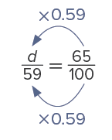
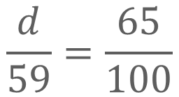
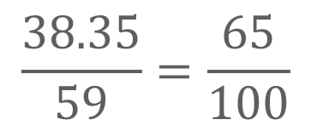
Example 1
Discounts
amount of discount
original price
$$\frac{d}{59}=\frac{65}{100}$$
Percent
Because 100 × 0.59 = 59, multiply 65 by 0.59 to find the value of d.
$$\frac{38.35}{59}=\frac{65}{100}$$
65 × 0.59 = 38.35, so, d = 38.35.
Subtract the discount from the original price. The sale price is
$59 − $38.35, or $20.65.

Slide 13
Example 1
Discounts
Talk About It!
In Method 1, why is the answer not $38.35?

Slide 14
Example 1
Discounts
Method 2 Subtract the discount percent from 100%.
Because 100% represents the original price, subtract the percent of the discount from 100%. The sale price is 100% − 65% or 35% of the original price. Then write a proportion and solve using ratio reasoning. Let x represent the sale price.

Slide 15
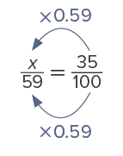
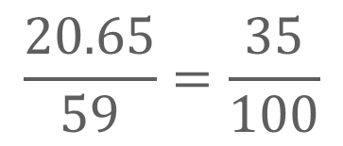
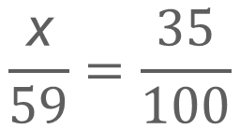
Example 1
Discounts
sale price
original price
$$\frac{\text{x}}{59}=\frac{35}{100}$$
Percent
Because 100 × 0.59 = 59, multiply 35 by 0.59 to find the value of x.
$$\frac{20.65}{59}=\frac{35}{100}$$
35 × 0.59 = 20.65, so, x = 20.65.
So, using either method, the sale price is $20.65.

Slide 16
Example 1
Discounts
Check
A restaurant decreased their prices for a day to their prices from 1964. A pizza that usually sells for $15.40 was marked down 85%. What was the price of the pizza in 1964? Use any strategy.

Slide 17
Example 1
Discounts
Check
A restaurant decreased their prices for a day to their prices from 1964. A pizza that usually sells for $15.40 was marked down 85%. What was the price of the pizza in 1964? Use any strategy.
$2.31
Notes:
$2.31

Slide 18
Example 2
Combined Discounts
During a clearance sale at an electronics store, certain tablets were marked down 20%. One day, an additional 30% was taken off already-reduced prices. A tablet originally sold for $375.
What was the final price after both discounts were applied?

Slide 19
Example 2
Combined Discounts
Think About It!
How can you estimate the solution?

Slide 20
Example 2
Combined Discounts
Step 1 Find the price after the first discount.
Because 100% represents the original price, subtract the percent of the original discount from 100%. The sale price is 100% − 20% or 80% of the original price. Then write a proportion and solve using ratio reasoning. Let x represent the sale price after the first discount.

Slide 21
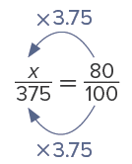
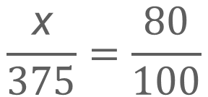
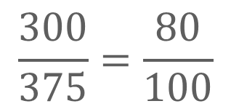
Example 2
Combined Discounts
sale price
original price
$$\frac{\text{x}}{375}=\frac{80}{100}$$
Percent
Because 100 × 3.75 = 375, multiply 80 by 3.75 to find the value of x.
$$\frac{300}{375}=\frac{80}{100}$$
80 × 3.75 = 300, so, x = 300. The
price after the first discount is $300.

Slide 22
Example 2
Combined Discounts
Step 2 Find the final price after the additional discount.
Because 100% now represents the price after the first discount, subtract the percent of the additional discount from 100%. The sale price is 100% − 30% or 70% of the price after the first discount. Then write a proportion and solve using ratio reasoning. Let x represent the sale price after the additional discount.

Slide 23
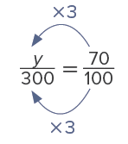
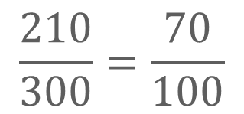
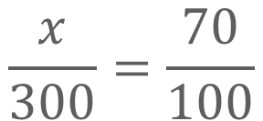
Example 2
Combined Discounts
sale price
original price
$$\frac{x}{300}=\frac{70}{100}$$
Percent
Because 100 × 3 = 300, multiply 70 by 3 to find the value of x.
$$\frac{210}{300}=\frac{70}{100}$$
70 × 3 = 210, so, x = 210.
So, the final price of the tablet after both discounts were applied was $210.

Slide 24
Example 2
Combined Discounts
Talk About It!
The final price had a discount of 20% followed by a discount of 30%. Is this the same as finding 20% + 30% or 50% of the original price? Use the values in the Example to justify your reasoning.

Slide 25
Example 2
Combined Discounts
Check
A clothing store marked all of their summer clothes down 50%. A sign in the store indicates that an additional 20% is to be taken off clearance prices. What is the final price of a top that originally sold for $58?

Slide 26
Example 2
Combined Discounts
Check
A clothing store marked all of their summer clothes down 50%. A sign in the store indicates that an additional 20% is to be taken off clearance prices. What is the final price of a top that originally sold for $58?
$23.20
Notes:
$23.20

Slide 27
Example 3
Find the Original Price
Sandy has a 25% discount coupon for athletic equipment. She buys hockey equipment for a final price of $172.50.
What is the original price?

Slide 28
Example 3
Find the Original Price
Think About It!
Are you trying to find the part, percent, or whole?

Slide 29
Example 3
Find the Original Price
If the amount of the discount is 25%, the sale price is 100% − 25%, or 75%, of the original price. So, 75% of the original price is $172.50.
Write a proportion and solve using ratio reasoning. Let x represent the original price.

Slide 30
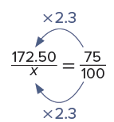
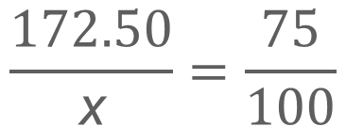
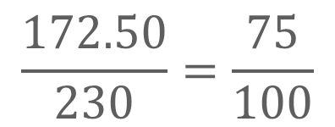
Example 3
Find the Original Price
sale price
original price
$$\frac{172.50}{\text{x}}=\frac{75}{100}$$
Percent
Because 75 × 2.3 = 172.50, multiply 100 by 2.3 to find the value of x.
$$\frac{172.50}{230}=\frac{75}{100}$$
100 × 2.3 = 230, so, x = 230.
So, the original price of the hockey equipment is $230.

Slide 31
Example 3
Find the Original Price
Talk About It!
When writing the proportion, why is the percent 75 out of 100 instead of 25 out of 100?

Slide 32
Example 3
Find the Original Price
Check
A pair of running shoes is on sale for $125.99. If the sale price is discounted 9% from the original price, what is the original price? Round to the nearest cent.

Slide 33
Example 3
Find the Original Price
Check
A pair of running shoes is on sale for $125.99. If the sale price is discounted 9% from the original price, what is the original price? Round to the nearest cent.
$138.45
Notes:
$138.45

Slide 34
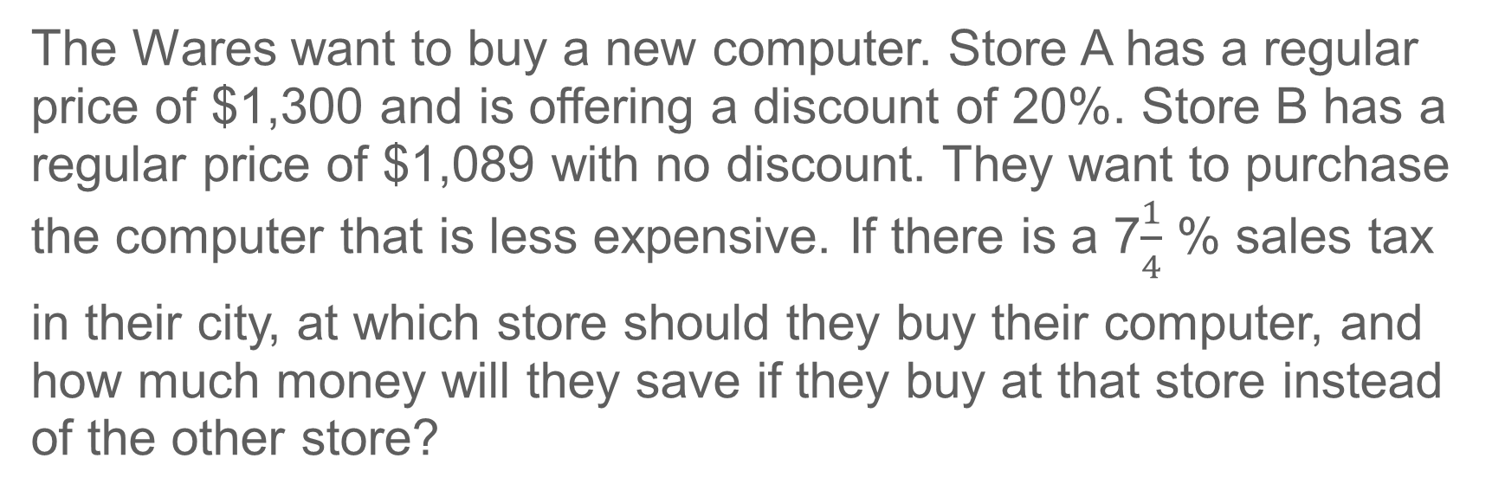
Apply
Shopping
The Wares want to buy a new computer. Store A has a regular price of $1,300 and is offering a discount of 20%. Store B has a regular price of $1,089 with no discount. They want to purchase
the computer that is less expensive. If there is a 7$\frac{1}{4}$ % sales tax
in their city, at which store should they buy their computer, and how much money will they save if they buy at that store instead of the other store?
Notes:
Yes; 31.3 feet

Slide 35
Apply
Shopping
Talk About It!
How can you quickly determine which computer will be cheaper before the sales tax is applied?

Slide 36
Apply
Shopping
Check
A bike shop has two road bikes on sale. The Road Warrior has a regular price of $379 and is discounted 25%. The Road Racer has a regular price of $320 and is discounted 12%. If the sales tax rate is 6.5%, which bike has the less expensive sale price? How much will you save by buying that bike?

Slide 37
Apply
Shopping
Check
A bike shop has two road bikes on sale. The Road Warrior has a regular price of $379 and is discounted 25%. The Road Racer has a regular price of $320 and is discounted 12%. If the sales tax rate is 6.5%, which bike has the less expensive sale price? How much will you save by buying that bike?
Road Racer; you would save $2.82.
Notes:
Road Racer; you would save $2.82.

Slide 38
Pause and Reflect
Write a paragraph explaining why a 30% discount is not the same as a 20% discount plus an additional 10% discount. Which is the better discount?

Slide 39
Exit Ticket
Suppose you see a T-shirt you would like to buy that was originally $19.99 and is on sale for 25% off. You have $15 with you. Will you have enough money to buy the T-shirt, before tax? Write a mathematical argument that can be used to defend your solution.

Slide 40
Exit Ticket
Suppose you see a T-shirt you would like to buy that was originally $19.99 and is on sale for 25% off. You have $15 with you. Will you have enough money to buy the T-shirt, before tax? Write a mathematical argument that can be used to defend your solution.
yes; Sample answer: To find the amount of the discount, multiply the original price of the T-shirt, $19.99, by the percent of discount, 25% or 0.25. To find the discounted price of the T-shirt before tax, subtract the amount of the discount from the original price of the T-shirt. The discounted price of the T-shirt is $14.99, which is less than $15, so you have enough to purchase the T-shirt, before tax.
Notes:
Yes; Sample answer: To find the amount of the discount, multiply the original price of the T-shirt, $19.99, by the percent of discount, 25% or 0.25. To find the discounted price of the T-shirt before tax, subtract the amount of the discount from the original price of the T-shirt. The discounted price of the T-shirt is $14.99, which is less than $15, so you have enough to purchase the T-shirt, before tax.

